Slide 1




CUSTOMER SEGMENTATION
STUDENT NAME: S. KIRTHIKA
REGISTER NO: 422200033
DEPARTMENT: 3rd B.COM(ISM)
COLLEGE: S.I.V.E.T College

Slide 2
PROJECT TITLE
CUSTOMER SEGMENTATION

Slide 3


AGENDA
Problem Statement
Project Overview
End Users
Our Solution and Proposition
Dataset Description
Modelling Approach
Results and Discussion
Conclusion
3/21/2024 Annual Review

Slide 4

PROBLEM STATEMENT
"Our company is facing difficulties in understanding the varying needs, behaviors, and preferences of our diverse customer base. Currently, we are unable to tailor marketing strategies effectively, resulting in suboptimal customer engagement, low conversion rates, and inefficient use of resources.We need to develop a robust customer segmentation model that will divide our customers into distinct groups based on shared characteristics such as demographics, purchasing behavior, and preferences. This segmentation will enable us to personalize our marketing efforts, improve customer satisfaction, and optimize product offerings for each segment, ultimately driving growth and increasing customer

Slide 5

PROJECT OVERVIEW
The goal of this project is to segment customers into distinct groups based on shared characteristics, such as demographic information, purchasing behavior, interests, and preferences. By doing so, the company aims to tailor its marketing, product development, and customer service strategies to meet the specific needs of each segment, improving customer satisfaction, increasing retention, and boosting overall business performance

Slide 6

WHO ARE THE END USERS?
Marketing TeamHow they use it:Tailor marketing campaigns, promotions, and messaging to specific customer segments.Design personalized email campaigns, social media strategies, and content marketing based on segment preferences.Optimize customer acquisition and retention strategies by targeting high-value segments.Allocate budget effectively across different channels and segments.Benefit:Improved ROI on marketing spend and better customer engagement.
2. Sales TeamHow they use it:Identify high-potential customer segments for targeted outreach and lead generation.Personalize sales pitches and product recommendations based on customer needs.Prioritize follow-up efforts with customers in more profitable or active segments.Benefit:Increased conversion rates and more efficient .

Slide 7

OUR SOLUTION AND ITS VALUE PROPOSITION
Customer segmentation offers significant value to businesses by enabling them to understand and target their customers more effectively. Here's a detailed breakdown of the value proposition that customer segmentation provides:
Personalized Customer Experience
Improved Marketing Efficiency
Enhanced Product Development
Increased Customer Retention and Loyalty
Better Resource Allocation
Data-Driven Decision Making

Slide 8
Dataset Description
In a customer segmentation project, the dataset typically contains information related to customer demographics, behaviors, and interactions with the company’s products or services. A well-structured dataset is crucial for building accurate and meaningful customer segments. Below is a typical structure and description of the key components you might find in a customer segmentation dataset:
Customer Demographic Information
Behavioral Data
Transactional Data

Slide 9

THE "WOW" IN OUR SOLUTION
A customer segmentation solution involves using data-driven methods to categorize customers into distinct groups based on shared characteristics, behaviors, and preferences. This segmentation enables businesses to tailor their marketing, product development, and customer service strategies to better meet the needs of each group.
3/21/2024 Annual Review
9

Slide 10
MODELLING
Customer segmentation modeling is a process used to divide a customer base into distinct groups based on their characteristics, behaviors, or needs. This allows businesses to tailor their marketing, sales, and customer service efforts to each segment, increasing effectiveness and efficiency.*Types of Customer Segmentation Models:*1. *Demographic Segmentation*: Based on age, gender, income, education, occupation, etc.2. *Behavioral Segmentation*: Based on purchase history, frequency, loyalty, etc.3. *Psychographic Segmentation*: Based on values, attitudes, lifestyle, interests, etc.4. *Firmographic Segmentation* (B2B): Based on company size, industry, revenue, etc.5. *Transactional Segmentation*: Based on transaction history, purchase value, etc.*Customer Segmentation Modeling Techniques:*1. *Cluster Analysis*: Grouping similar customers using statistical methods (e.g., k-means).2. *Regression Analysis*: Identifying relationships between customer characteristics and behavior.3. *Decision Trees*: Visualizing customer segments using tree-like models.4. *Neural Networks*: Using machine learning algorithms to identify complex patterns.5. *Latent Class Analysis*: Identifying unobserved customer segments.*Benefits of Customer Segmentation Modeling:*1. *Improved targeting*: Focus on high-value customers.2. *Enhanced customer experience*: Personalized interactions.3. *Increased efficiency*: Reduced waste in marketing and sales.4. *Better resource allocation*: Prioritize segments with highest potential.5. *Competitive advantage*: Unique customer insights.*Common Metrics Used:*1. *RFM (Recency, Frequency, Monetary)*: Measures purchase behavior.2. *Customer Lifetime Value (CLV)*: Estimates lifetime revenue.3. *Churn Rate*: Measures customer retention.
10

Slide 11
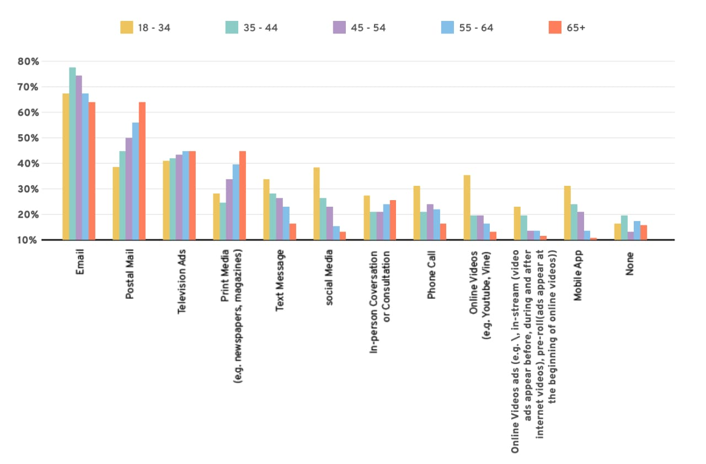
RESULTS
11

Slide 12
conclusion
A customer segmentation solution provides a data-driven approach to understanding and targeting distinct groups of customers. By analyzing customer data through methods like clustering or RFM analysis, businesses can create meaningful segments, improve marketing strategies, personalize customer experiences, and drive overall business growth. This segmentation process leads to more efficient resource allocation, increased customer retention, and enhanced profitability.

